Slide 1
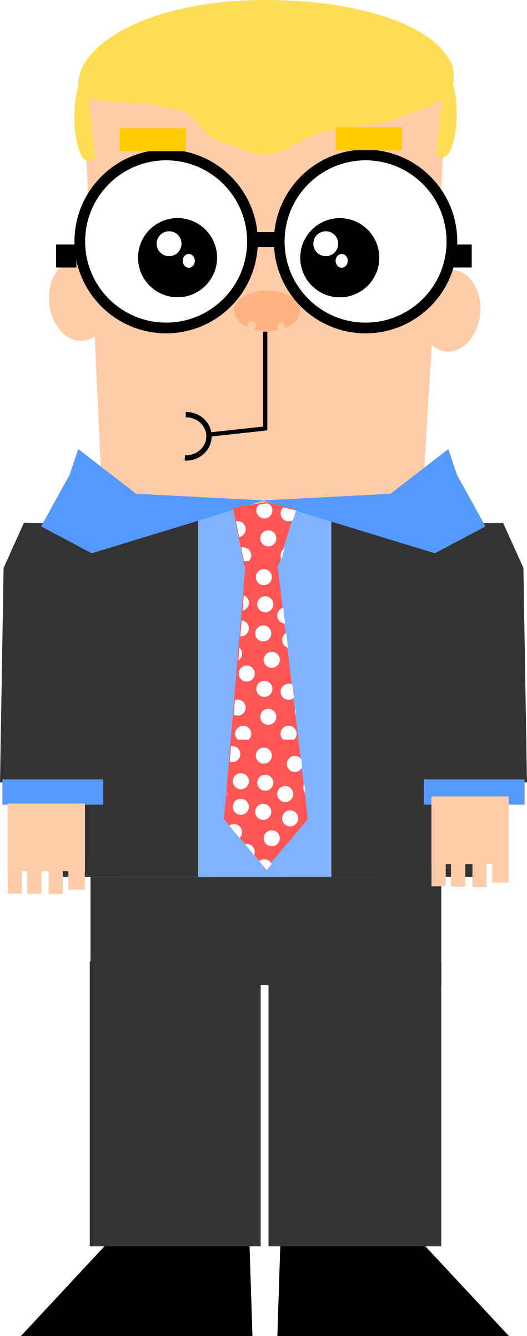
“I don't let my visual impairment stop me from enjoying life and work. I just need the right tools and information to make it easier”
Add image that represents this persona
Goals
Clear and accurate descriptions and audio cues, nutritional information and allergen warnings
Minimization the energy they have to put into specific needs so they can focus on their personal life and work
Frustrations
It’s often too poorly prepared to accommodate my visual impairment
Sometimes it can be improved by having more relevant results, more personalized recommendations
Tom
Age:
Education:
Hometown:
Family:
Occupation:
38
Management
Toronto
Married, 1 kid, 1 dog
Project manager
Tom is a successful PM in an international firm. He has a visual impairment for which he uses screen reader technologies. But not all apps and websites are optimized for screen reader usage. Him and his family loves modern restaurants where they can order nourishing, wholesome meals.

Slide 2

“I'm still learning English, so I appreciate apps that have attractive photos and translations”
Goals
Clear and attractive photos and translations
Filters and categories for different cuisines and diets
Ratings and reviews from other users
Frustrations
Feels overwhelmed when cannot understand readings in English or when speaking to people
Apps usually have limited options to explore more food and dishes
Emi
Age:
Education:
Hometown:
Family:
Occupation:
23
Enrolled in musical college
Vancouver
Single with a dog
Student
Emi is a recent immigrant to Canada who is studying music in a Vancouver college. She plays several instruments and likes to explore new cuisines, but still having some issues with English. Besides the college she likes going to restaurants and enjoy trying new food. She can read English well, but sometimes encounters difficulties at restaurants or while out running errands.

